Slide 1

चरैवेति, चरैवेति
Keep progressing to attain a higher self.
avinash.bhagat@lpu.co.in Avinash Bhagat 9463281930

Slide 2
CAP275: Data Communication and Networking
Lecture # 17-19
Data Link layer
Flow control protocols
avinash.bhagat@lpu.co.in Avinash Bhagat 9463281930

Slide 3

Data Link Layer

Slide 4
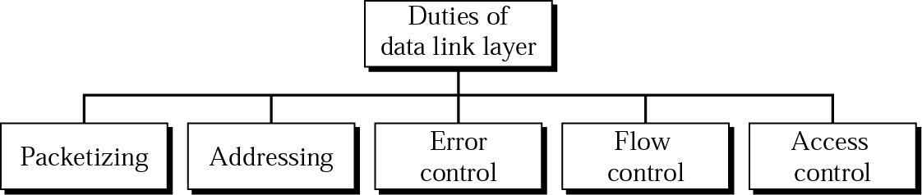
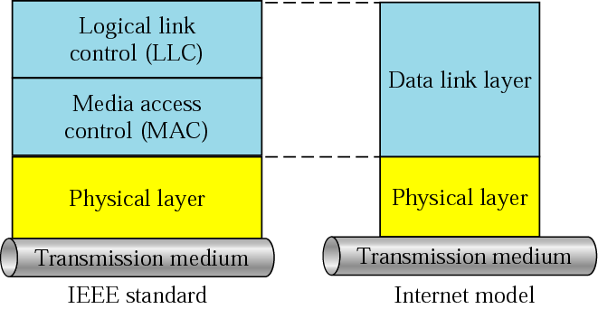
LLC and MAC sublayers

Slide 5
Framing
The data link layer needs to pack bits into frames, so that each frame is distinguishable from another.
Fixed-Size Framing
Variable-Size Framing
In variable-size framing, we need a way to define the end of the frame and the beginning of the next.
    Bit oriented
    Character Oriented

Slide 6

A frame in a bit-oriented protocol
in addition to headers (and possible trailers), we still need a delimiter to separate one frame from the other.
Most protocols use a special 8-bit pattern flag 01111110 as the delimiter to define the beginning and the end of the frame,

Slide 7
Bit stuffing and unstuffing
Bit stuffing is the process of adding one extra 0 whenever five consecutive 1s follow a 0 in the data, so that the receiver does not mistake
the pattern 0111110 for a flag.

Slide 8

Bit stuffing and unstuffing

Slide 9

A frame in a character-oriented protocol
In a character-oriented protocol, data to be carried are 8-bit characters
The header,
  which normally carries the source and destination addresses
  and other control information,
the trailer, which carries
  error detection or error correction redundant bits, are also multiples of 8 bits.
To separate one frame from the next, an 8-bit (I-byte) flag is added at the beginning and the end of a frame.

Slide 10

Byte stuffing and unstuffing

Slide 11

FLOW AND ERROR CONTROL
The most important responsibilities of the data link layer are flow control and error control.

Slide 12
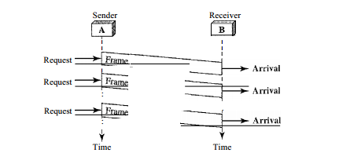
NOISELESS CHANNELS
Let us first assume we have an ideal channel in which no frames are lost, duplicated, or corrupted. We introduce two protocols for this type of channel.
Simplest Protocol
Stop-and Wait Protocol
Notes:
Our first protocol, which we call the Simplest Protocol for lack of any other name, is one that has no flow or error control.
It is a unidirectional protocol in which data frames are traveling in only one direction-from the sender to receiver.
We assume that the receiver can immediately handle any frame it
receives with a processing time that is small enough to be negligible.
The data link layer of the receiver immediately removes the header from the frame and hands the data packet to its network layer, which can also accept the packet immediately.

Slide 13
Stop and Wait Flow control
The simplest form of flow control.
The source transmits a data frame
After receiving the frame the destination indicates its willingness to accept another frame by sending back an ACK frame acknowledging the frame just received.
The source must wait until it receives the ACK frame before sending the next data

Slide 14
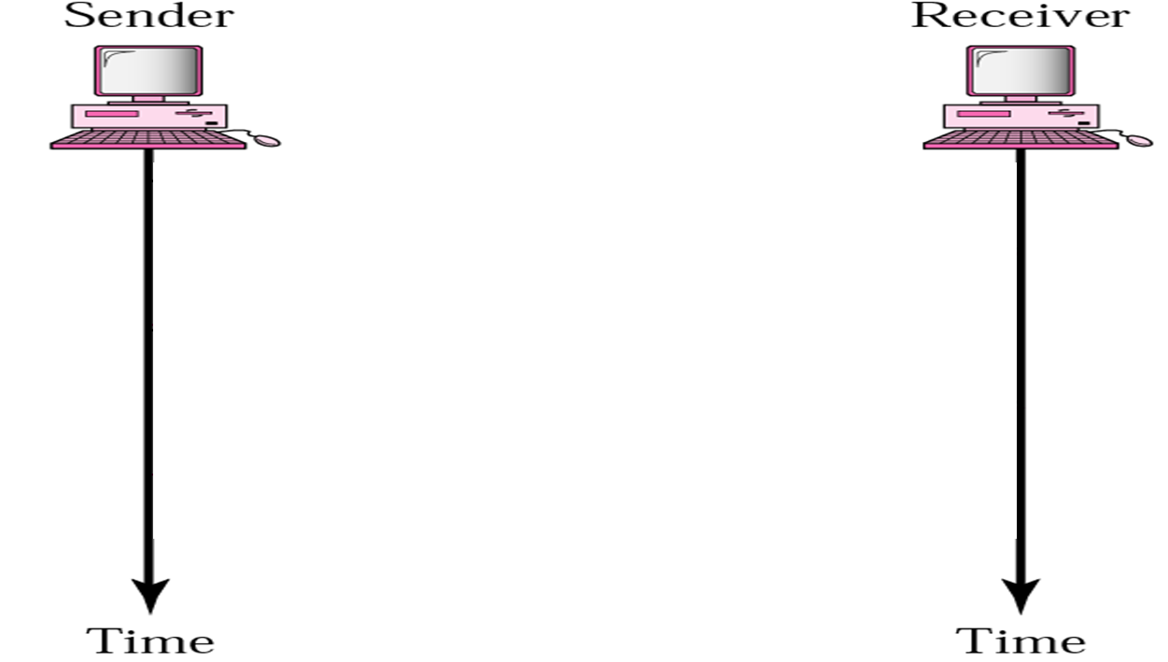











Slide 15
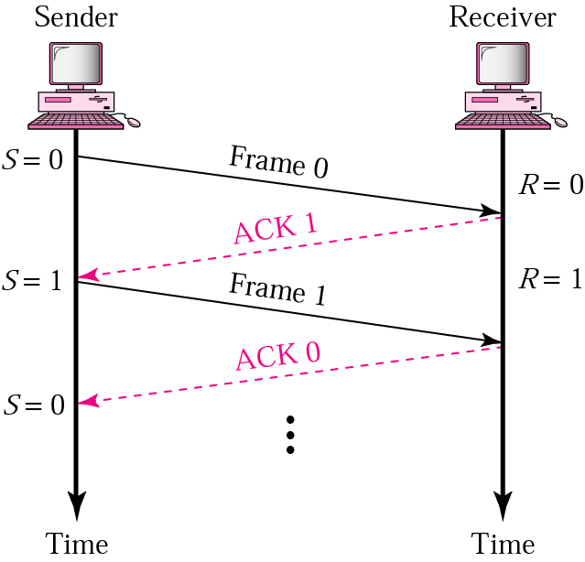

Slide 16
NOISY CHANNELS
Stop-and-Wait Automatic Repeat Request
Go-Back-N Automatic Repeat Request
Selective Repeat Automatic Repeat Request
Notes:
Although the Stop-and-Wait Protocol gives us an idea of how to add flow control to its predecessor, noiseless channels are nonexistent. We discuss three protocols in this section that use error control.

Slide 17
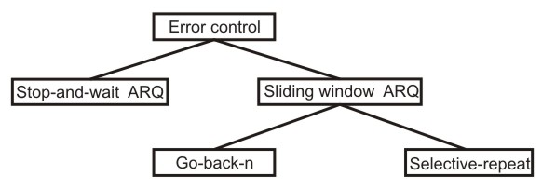
NOISY CHANNELS

Slide 18
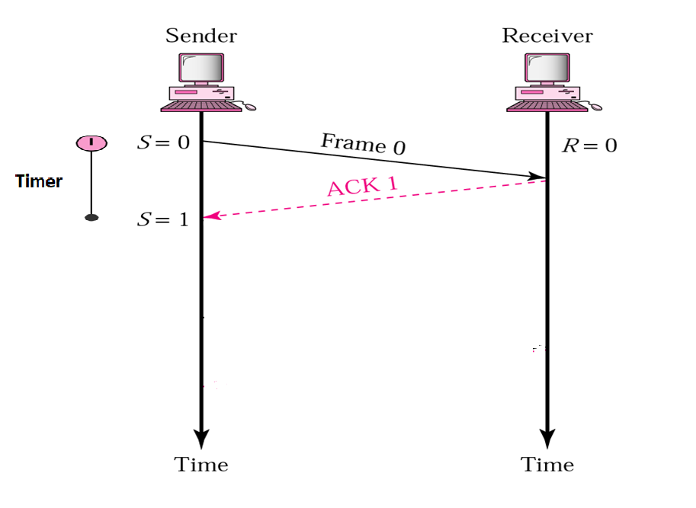
Stop-and-Wait ARQ

Slide 19
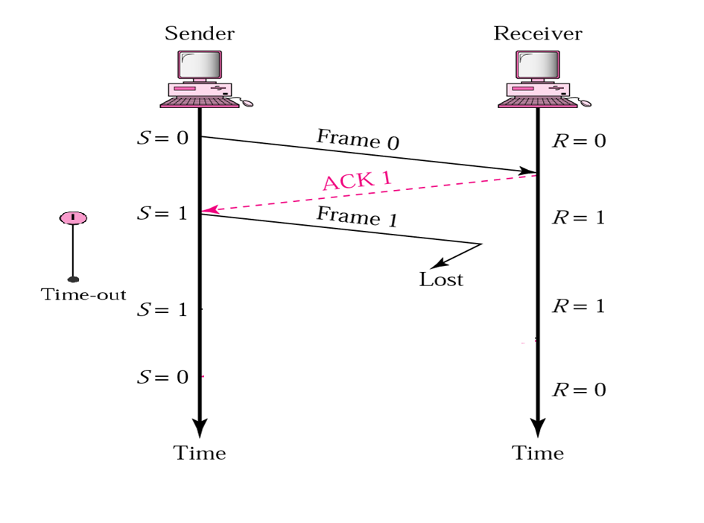
Stop-and-Wait ARQ

Slide 20
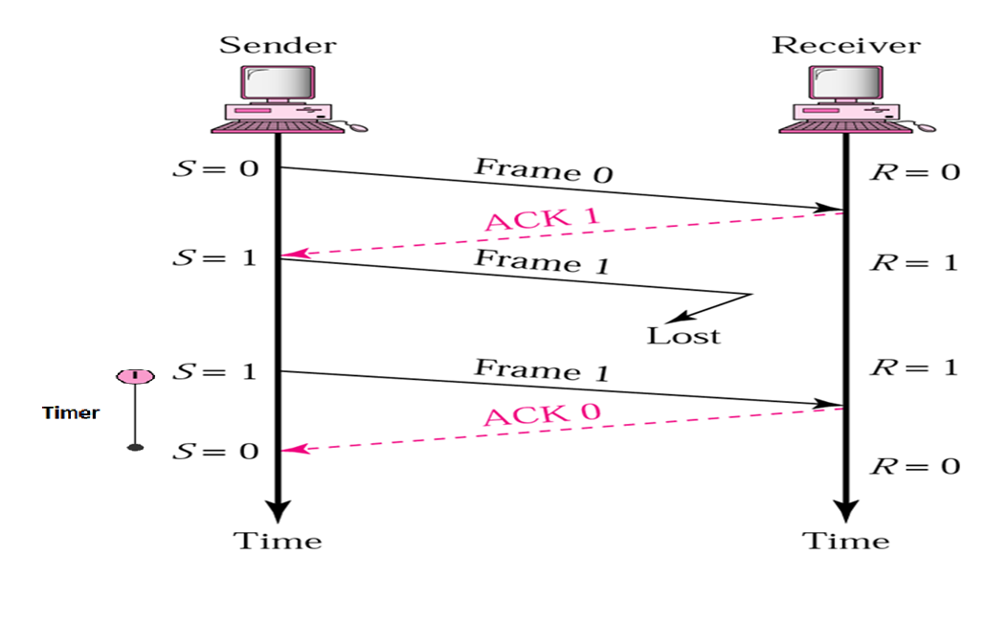
Stop-and-Wait ARQ

Slide 21
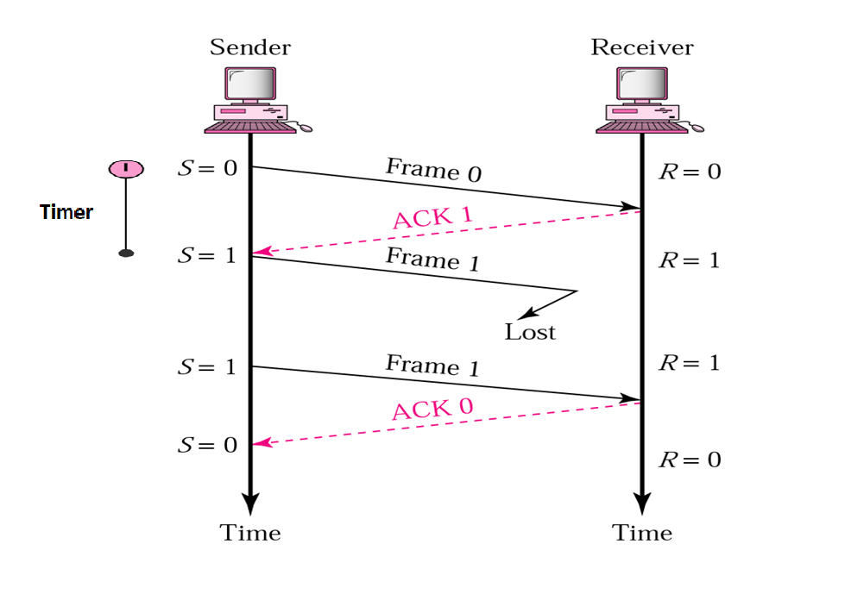
Stop-and-Wait ARQ

Slide 22
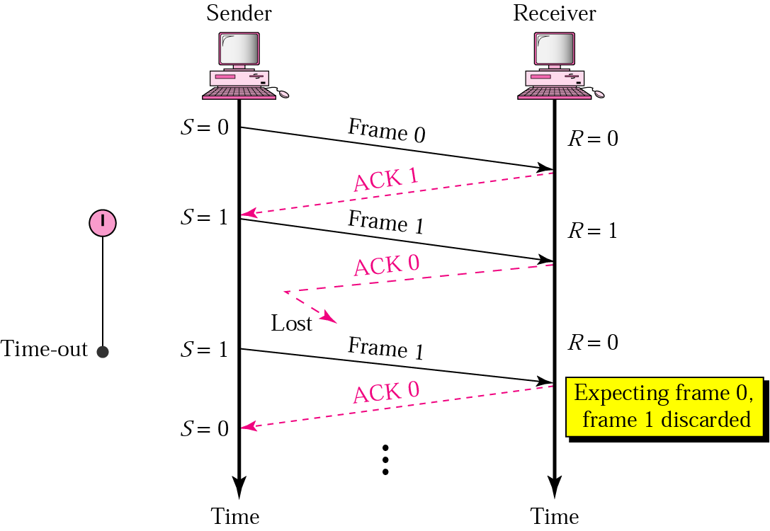
Stop-and-Wait ARQ, lost ACK frame

Slide 23
Stop-and-Wait ARQ
Based on stop and wait flow control technique
Sender transmits a frame and then waits till it receives positive acknowledgement (ACK) or negative acknowledgement (NACK) from the receiver .
Receiver sends an ACK if the frame is received correctly, otherwise it sends NACK.
Transmitter sends a new frame after receiving ACK; otherwise it retransmits the old frame, if it receives a NACK

Slide 24
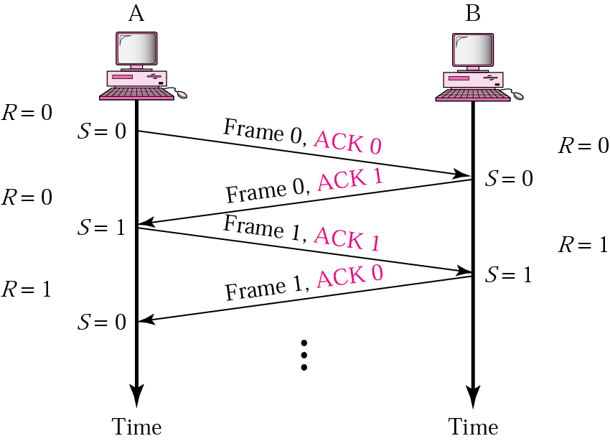
Piggybacking

Slide 25

Notes:
Major drawback of Stop-and-Wait Flow Control is that only one frame can be in transmission at a time, this leads to inefficiency if propagation delay is much longer than the transmission delay.
To take care of lost and damaged frame the stations are :
Equipped with a timer, if no recognizable ACK is received when the timer expires at the end of the time out interval, then same frame is sent again.
Sender is required to maintain a copy of a transmitted frame until an ACK is received for it

Slide 26
Sliding Window Protocol Go Back -N
The stop-and-wait protocol does not perform well. Only one frame at a time can be in transit.
Efficiency can be greatly improved by allowing multiple frames to be in transit at the same time.
Efficiency can also be improved by making use of the full-duplex line.

Slide 27
Go back n ARQ
Based on sliding window protocol
Basic Concept:
  A station sends a series of frames sequentially up to a maximum number
  The number of unacknowledged frames outstanding is determined by window size, using the sliding window flow control technique.
  In case of no error, the destination will acknowledge incoming frames as usual.

Slide 28
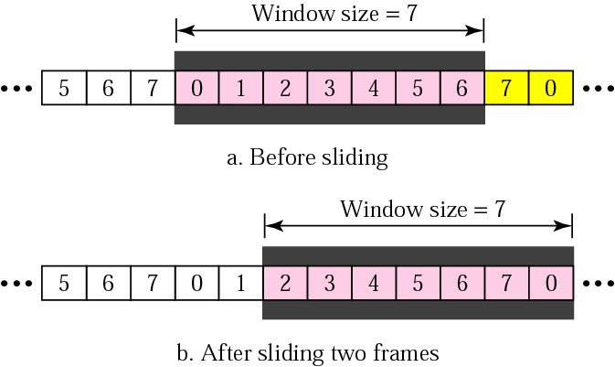
Sender sliding window
Size of window at sender side
if we decide that the field is m bits long, the sequence numbers start from 0, go to 2^{m} - 1, and then are repeated.

Slide 29
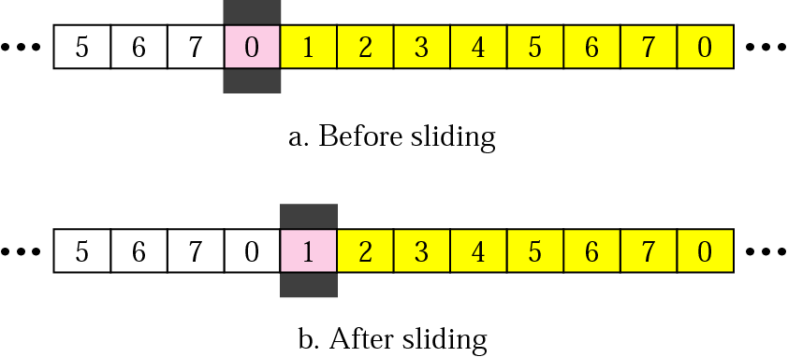
Receiver sliding window
Size of window at receiver side is 1

Slide 30

Sender side window for Go-Back-N ARQ

Slide 31

Receiver side window for Go-Back-N ARQ

Slide 32
Selective Repeat ARQ
In this case only those frames are retransmitted for which negative acknowledgement has been received, in this case called SREJ, or time out has occurred
It is more efficient than go back N
Receiver requires storage buffers to contain out of order frames until the frame in error is correctly received.
Transmitter is also more complex because it must be capable of sending frames out of sequence

Slide 33

Sender side window for Selective Repeat ARQ

Slide 34

Receiver side window for Selective Repeat ARQ

Slide 35
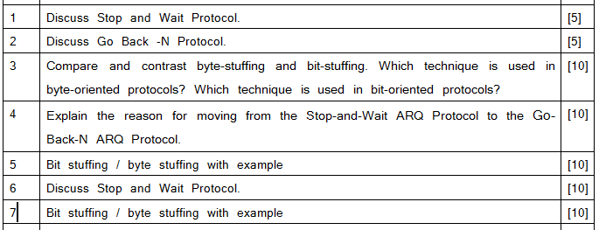
Review Questions

Slide 36
Multiple Choice Questions
In a Go-Back-N ARQ, if the window size is 63, what is the range of sequence numbers?
a. 0 to 63
b. 0 to 64
c. 1 to 63
d. 1 to 64
In Go-Back-N ARQ, if frames 4, 5, and 6 are received successfully, the receiver may send an ACK _______ to the sender.
a. 5
b. 6
c. 7
d. 4
For Stop-and-Wait ARQ, for 10 data packets sent, _______ acknowledgments are needed.
a. exactly 10
b. less than 10
c. more than 10
d. none of the above

Slide 37
Multiple Choice Questions
In a Go-Back-N ARQ, if the window size is 63, what is the range of sequence numbers?
a. 0 to 63
b. 0 to 64
c. 1 to 63
d. 1 to 64
In Go-Back-N ARQ, if frames 4, 5, and 6 are received successfully, the receiver may send an ACK _______ to the sender.
a. 5
b. 6
c. 7
d. 4
For Stop-and-Wait ARQ, for 10 data packets sent, _______ acknowledgments are needed.
a. exactly 10
b. less than 10
c. more than 10
d. none of the above

Slide 38
Multiple Choice Questions
In _______ the data link layer separates a message from one source to a destination, or from other messages going from other sources to other destinations.
a. Digitizing
b. Controlling
c. Framing
d. none of the above
In a ________ protocol, the data section of a frame is a sequence of characters.
a. bit-oriented
b. character-oriented
c. either (a) or (b)
d. none of the above
In a _________ protocol, the data section of a frame is a sequence of bits.
a. byte-oriented
b. bit-oriented
c. either (a) or (b)
d. none of the above

Slide 39
Multiple Choice Questions
In _______ the data link layer separates a message from one source to a destination, or from other messages going from other sources to other destinations.
a. Digitizing
b. Controlling
c. Framing
d. none of the above
In a ________ protocol, the data section of a frame is a sequence of characters.
a. bit-oriented
b. character-oriented
c. either (a) or (b)
d. none of the above
In a _________ protocol, the data section of a frame is a sequence of bits.
a. byte-oriented
b. bit-oriented
c. either (a) or (b)
d. none of the above

Slide 40
References :
Text Book:
  Behrouz A. Forouzan, Data Communication and networking, 4th Ed., Tata McGraw Hills year of publication 2006
Other Specific Book:
  Andrew S. Tanenbaum,Computer Network 2nd Edition, PHI, Third Edition 1997
  Comer E. Doughlas,Computer Networks and Internets, 2nd Ed., Pearson, 2000
  W. Stallings,Data and Computer Communications, 7th Ed., Pearson, 2002.

Slide 41

See you in next class

